Slide 1
PPT 3 UI
Name : KAVURU DEVI SRIKAR
Roll No. 25WU0102123
Section : AIML PANTHERS

Slide 2
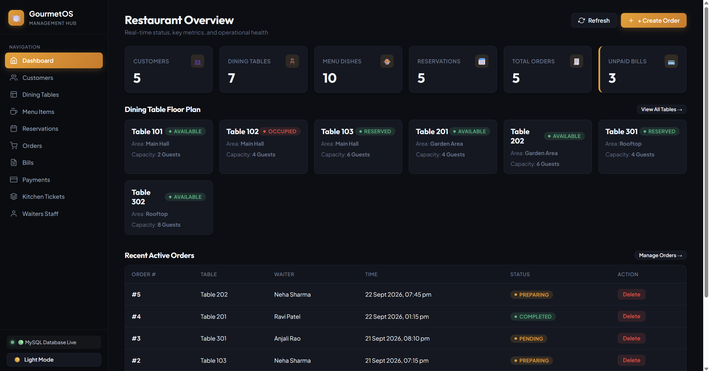

Slide 3
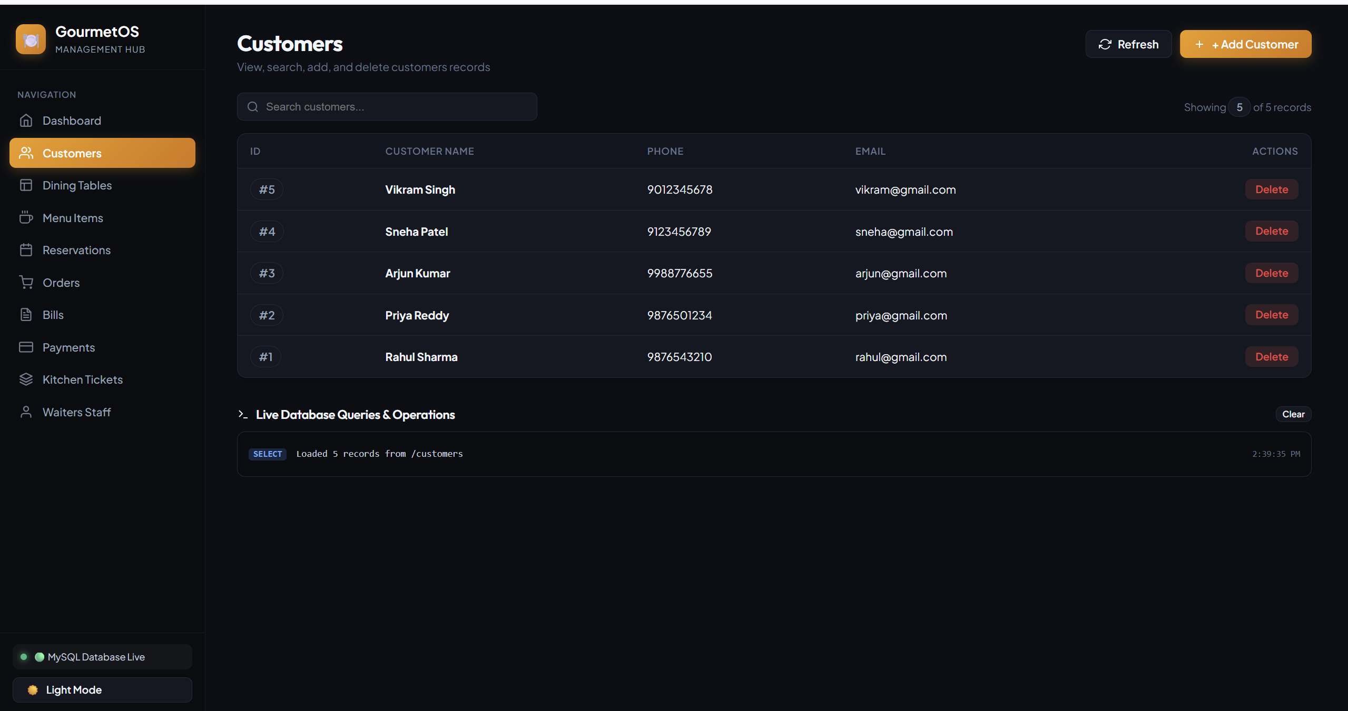

Slide 4
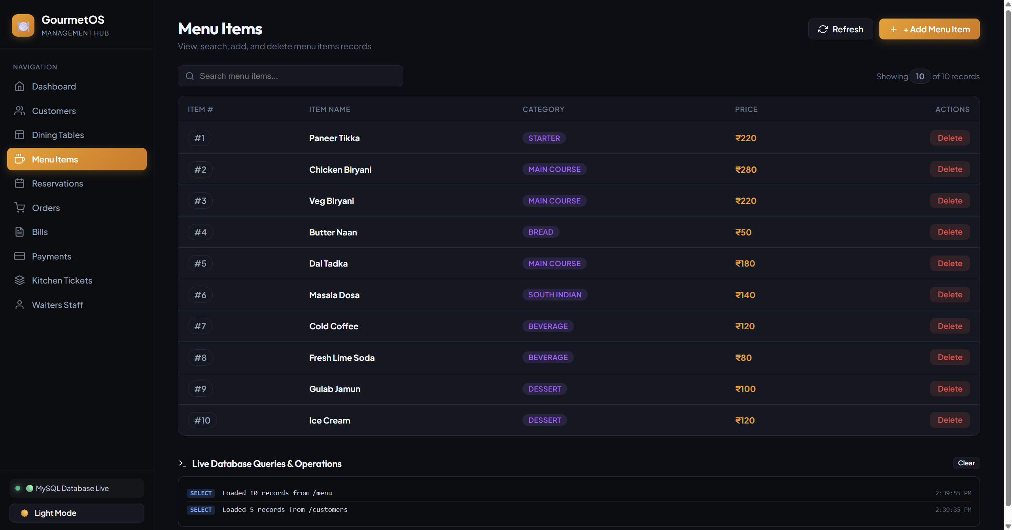

Slide 5
